Slide 1
ARITIFICAL INTELLIGENCE

Slide 2
agenda
Introduction
Types of AI
Revolution of AI

Slide 3
INTRODUCTION
Artificial Intelligence (AI) is a field focused on creating machines capable of performing tasks that typically require human intelligence.
These tasks can include understanding language, recognizing images, making decisions, and learning from data.
AI is used in various applications, including self-driving cars, virtual assistants (like Siri and Alexa), medical diagnosis, and customer service chatbots.

Slide 4
Types of AI Flow Chart
TYPES OF AI
Based on
capability
Narrow AI (Weak AI)
General AI (Strong AI)
Based on
functionality
Reactive Machines
Gen AI (Strong AI)
Theory of Mind AI
Limited Memory
Self-Aware AI

Slide 5
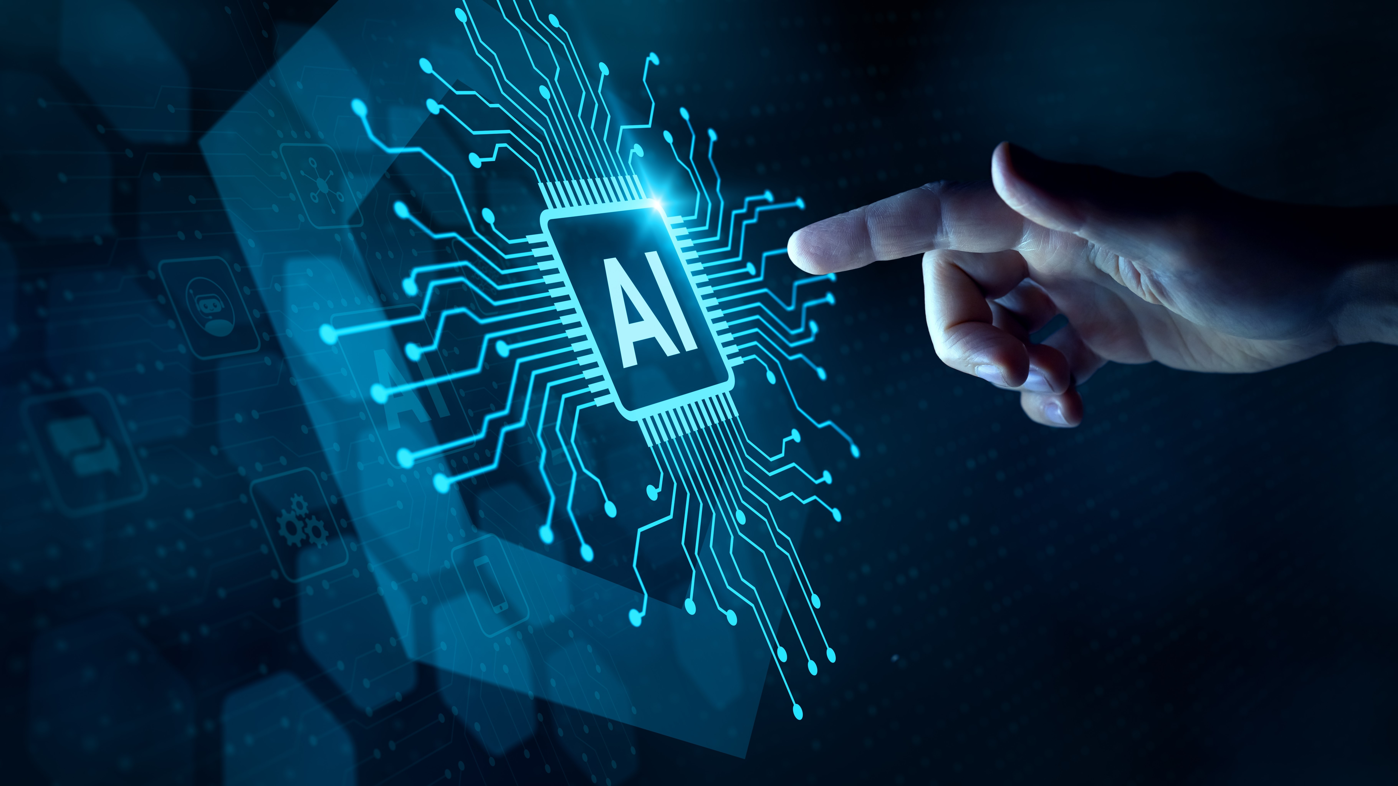

TYPES OF AI Description
BASED ON THEIR CAPABILITIES:
1.Narrow AI (Weak AI):
Designed to perform specific tasks or a narrow set of tasks. Examples include facial recognition, virtual assistants (Siri, Alexa), and recommendation engines.
2.General AI (Strong AI):
A hypothetical AI with human-like cognitive abilities, capable of performing any intellectual task a human can. This is the concept of Artificial General Intelligence (AGI).
3.Gen AI (Artificial Superintelligence):
AI that surpasses human intelligence in all aspects. This is a hypothetical future stage of AI development.

Slide 6
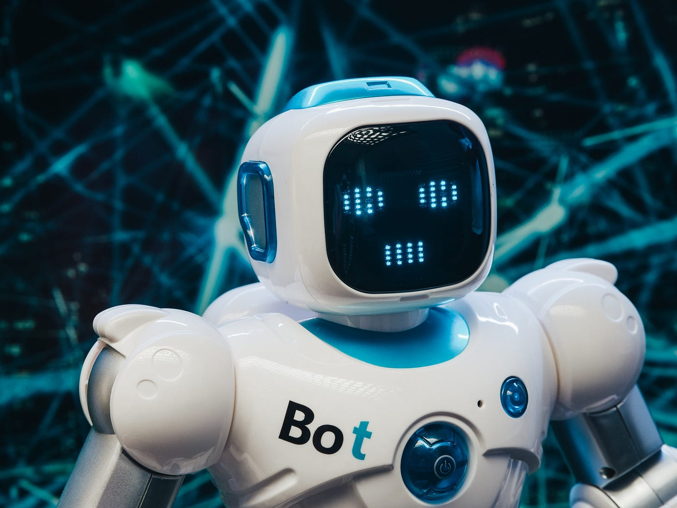
Types of ai description
BASED ON THEIR FUNCTIONALITY:
1.Reactive Machines: Reactive Machines in AI are systems that respond directly to input without any memory or learning from past experiences.
2.Theory of Mind: Theory of Mind AI is about giving machines the ability to understand and predict the human mental states , beliefs , intentions , emotions.
3.Limited Memory: Limited Memory refers to systems that temporarily store data for making decisions and to improve future prediction. It is used in machine learning applications.
4.Self - Aware AI: Self – Aware is a key building blocks of emotional intelligence. It is the ability of someone to recognize their emotions and to be able to tell what emotions they are experiencing.

Slide 7
REVOLUTION OF AI
1950- Turing Proposes Text
1997 – Deep Blue Victory
2018 – GPT model released
1956- Term “AI” Coined
1979 – Japan’s AI Project
1970 – First AI Conference
1956 – Eliza Chatbot
2002 – Roomba (Robotic vacuum cleaner) was Introduced
2011 - SIRI was developed
2014 – Amazon launches ALEXA
1999 – Sony launches first consumer robot pet Dog (AIBO)
2020 – GPT-3 launch
2021 – AI Advancement

Slide 8
Thank you
Documentation presented by
Y.REVATHI PRIYA

